Slide 1
Milestone 2
Tracey Kong, Kyra Abbu, Donald Chen

Slide 2
Problem
Description
Music can change an individual’ mood, fuel excitement, or provide calmness and relaxation. However, there is an endless amount of music. Songs are constantly created and released but an individual’s playlist can still become repetitive and tiring. The problem is that it is impossible to manually search billions of songs to identify one’s liking.
An even bigger problem is that music recommendation systems encounter the problem of taste. Taste is subjective and unique to an individual’s emotions at a certain time. Our proposal is to create a music recommendation system using state-of-the art algorithms and evaluation methods to maintain novelty, freshness, diversity, and popularity in a playlist.
Notes:
Donald
Music is a major part of our lives and with this comes the issue of music discovery. New songs are being created and released that we may never know of. We decided to create a playlist recommender to help with this task. We are using playlists because they are able to better represent the music one likes. The goal of this project is to be able to take a spotify playlist as an input and then output several playlists that are similar.

Slide 3
State of the Art and Related Works
Bag of Words (BoW) algorithm
creates a feature vector where each feature is a unique genre of the songs from an input playlist
Notes:
https://towardsdatascience.com/neural-network-embeddings-explained-4d028e6f0526 - Embeddings
https://arxiv.org/abs/1907.01098 - Paper the project is based on

Slide 4
State of the Art and Related Works
Bag of Words (BoW) algorithm
creates a feature vector where each feature is a unique genre of the songs from an input playlist
Sequence-to-Sequence (seq2seq) models
Uses two Recurrent Neural Networks (RNN) as a encoder and decoder. The encoder turns an input into a target vector and the decoder reverses the process.
Notes:
https://towardsdatascience.com/neural-network-embeddings-explained-4d028e6f0526 - Embeddings
https://arxiv.org/abs/1907.01098 - Paper the project is based on

Slide 5
State of the Art and Related Works
Bag of Words (BoW) algorithm
creates a feature vector where each feature is a unique genre of the songs from an input playlist
Sequence-to-Sequence (seq2seq) models
Uses two Recurrent Neural Networks (RNN) as a encoder and decoder. The encoder turns an input into a target vector and the decoder reverses the process.
(Optional) Top-N-Targets-Balanced Recommendation Based on Attentional Sequence-to-Sequence Learning
an algorithm with proven results of taking into account the changing interests and needs of the users as well as possible mistakes in choosing a song which can decrease the accuracy
Notes:
https://towardsdatascience.com/neural-network-embeddings-explained-4d028e6f0526 - Embeddings
https://arxiv.org/abs/1907.01098 - Paper the project is based on

Slide 6
Approach
We will be using a base and weighted Bag of Words(BoW) model, and a unidirectional and bidirectional Sequence to Sequence model to classify the playlists.
After classifying an input playlists, we will get an embedded vector that will then be used with K-Nearest-Neighbors to find similar playlists.
The embedded vector will consist of the parameters given by the Spotify API and the genre that is given by the algorithm
The parameters given by the Spotify API:
[duration, acousticness, danceability, energy, instrumentalness, liveness, loudness, speechness, valence,tempo]
The Spotify API does not assign genres to tracks but artists do have genres associated with them so we will match songs to their artist’s genre.
Notes:
Read 5 Experiment Setup in the paper - Not 100% sure of this
Maybe use LSTM instead of RNN

Slide 7
Team Roles
Tracey
Implement the base and BiDirectional seq2seq algorithms to classify playlists
Work on a simple web app to visualize the recommendation system
Kyra
Implement a KNN algorithm to extract results
Implement the Approximate Nearest Neighbors algorithm (Spotify ANNOY library) to extract results.
Donald
Implement the base and weighted BoW algorithms to classify playlists
Work on a simple web app to visualize the recommendation system
Notes:
Tracey

Slide 8
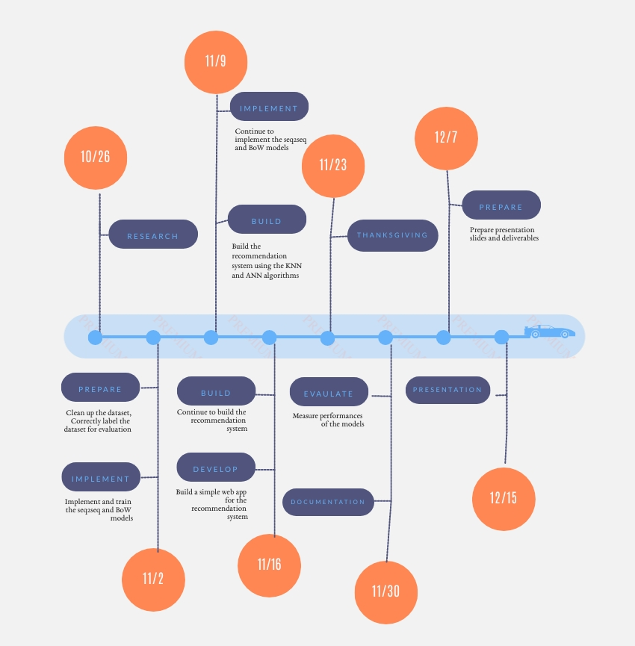
Timeline
Notes:
Tracey

Slide 9
Evaluation
^{Limitations}
Time
Notes:
Kyra

Slide 10
Evaluation
^{Limitations}
Time
User Input
Notes:
Recommendation systems are difficult to evaluate without user-labeled data. User-labeled data can be in the form of gathering the number of skips from the user among the songs in the playlist recommended.

Slide 11
Evaluation
^{Limitations}
Time
User Input
User Feedback

Slide 12
Evaluation
Evaluation
^{Limitations}
Time
User Input
User Feedback
Taste

Slide 13
Evaluation
^{Solution}
Offline Evaluation Method

Slide 14
Evaluation
Evaluation
^{Solution}
Offline Evaluation Method
: No user-labeled data but use KKBOX dataset to mimic users
Notes:
KKBOX is a leading music streaming service provider in East Asia. From KKBOX, we obtain a real-world dataset with 0.1 billion listening records from OCtober 2012 to September 2013. (Limitation)
We will explore more on using another dataset if we pass one.

Slide 15

Evaluation
^{Measurements}
Novelty
: Determines if the recommended songs are new to the user or not. Are they outside the user’s comfort zone?
Notes:
KKBOX is a leading music streaming service provider in East Asia. From KKBOX, we obtain a real-world dataset with 0.1 billion listening records from OCtober 2012 to September 2013. (Limitation)
We will explore more on using another dataset if we pass one.

Slide 16

Evaluation
^{Measurements}
Diversity
: Compute the genre histogram and defines the average entropy of the histogram.
Notes:
KKBOX is a leading music streaming service provider in East Asia. From KKBOX, we obtain a real-world dataset with 0.1 billion listening records from OCtober 2012 to September 2013. (Limitation)
We will explore more on using another dataset if we pass one.

Slide 17

Evaluation
^{Measurements}
Freshness
: Takes the average of the release date to determine new or old songs.
Notes:
KKBOX is a leading music streaming service provider in East Asia. From KKBOX, we obtain a real-world dataset with 0.1 billion listening records from OCtober 2012 to September 2013. (Limitation)
We will explore more on using another dataset if we pass one.

Slide 18
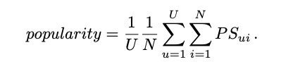
Evaluation
^{Measurements}
Popularity
: Measures the number of users that have listened to the song and takes the average of the top-N songs from the recommendation.
Notes:
KKBOX is a leading music streaming service provider in East Asia. From KKBOX, we obtain a real-world dataset with 0.1 billion listening records from OCtober 2012 to September 2013. (Limitation)
We will explore more on using another dataset if we pass one.

